Slide 1
Digital Portfolio
STUDENT NAME: kanimozhi M
REGISTER NO AND NMID: 2428B0319 And 37CA4C80A04B385AE7F4266E46C92079
DEPARTMENT: B Sc Computer Science With Data Analysis
COLLEGE: KPR College Arts Science And Research / Bharathiar University

Slide 2
Design Portfolio (Graphics/UI/UX)

Slide 3


AGENDA
Problem Statement
Project Overview
End Users
Tools and Technologies
Portfolio design and Layout
Features and Functionality
Results and Screenshots
Conclusion
Github Link
3/21/2024 Annual Review

Slide 4

PROBLEM STATEMENT
Many small and mid-sized businesses struggle to establish a strong digital presence because their existing websites and applications lack intuitive navigation, visual consistency, and engaging user experiences. Current solutions often prioritize aesthetics over usability, leading to confusing layouts, accessibility issues, and low customer retention.

Slide 5

PROJECT OVERVIEW
This project focuses on designing a modern and user-centered digital experience that combines aesthetics, usability, and accessibility. The goal is to create a visual identity and interface design that not only looks appealing but also solves real usability challenges faced by users.Through a structured design process—research, ideation, wireframing, prototyping, and testing—the project explores how thoughtful design decisions can enhance brand presence, simplify navigation, and improve overall user interaction.

Slide 6

End Users General Users / CustomersPeople who will interact with the website, mobile app, or product interface. Expect easy navigation, clear visuals, and smooth interactions. 2. Clients / BusinessesCompanies or individuals who commission the design work.Expect brand consistency, market appeal, and professional presentation. 3. Stakeholders / InvestorsDecision-makers who evaluate how design impacts business goals.Expect clarity in information design, user engagement, and trustworthiness.

Slide 7

TOOLS AND TECHNIQUES
Canva / Figma – Quick visual design, social media graphics.Procreate – Digital illustration and concept art. TechniquesGraphics
GraphicsBranding & Visual Identity (logos, typography, color palettes).Layout & Composition Principles (balance, contrast, hierarchy).Illustration & Iconography.Responsive & Scalable Visuals.

Slide 8
POTFOLIO DESIGN AND LAYOUT
Minimalist Grid LayoutHome Page: Clean hero section with your name, tagline (“UI/UX Designer & Visual Storyteller”), and a strong call-to-action.Projects Section: Grid cards with thumbnail previews of each project (hover animations can reveal title + short description).Case Study Layout:Problem StatementProject OverviewTools & TechniquesDesign Process (wireframes → prototypes → final UI)Final Designs (mockups/screenshots)Outcomes & Learnings
8

Slide 9
FEATURES AND FUNCTIONALITY
Homepage Hero Section – Name, tagline, and a clear “View My Work” CTA.Project Showcase / Case Studies – Each project presented with problem → process → solution → final designs.About Me Section – Your background, design philosophy, and specialties.Skills & Tools Section – Visual icons/logos for tools (Figma, Photoshop, Illustrator, etc.).Contact Section – Email, LinkedIn, Behance, or a built-in contact form.

Slide 10
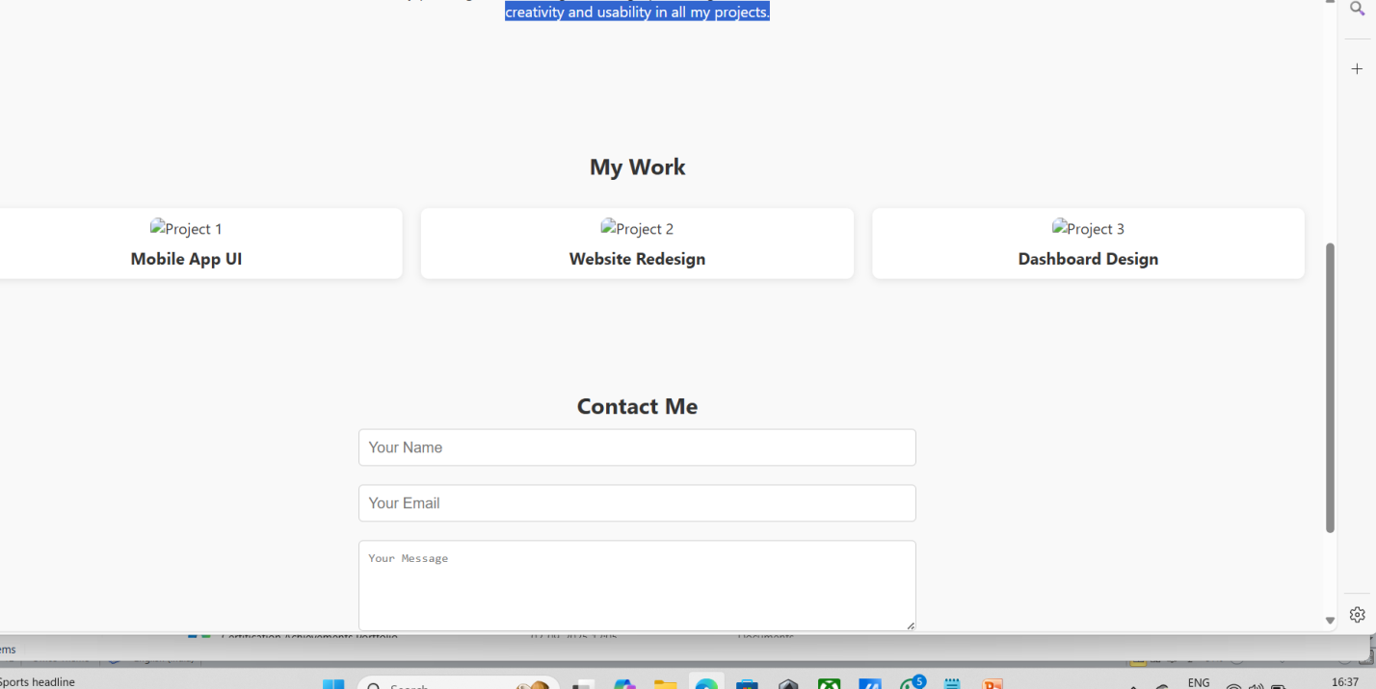

RESULTS AND SCREENSHOTS
Improved user navigation, reducing task completion time by 35%.Increased customer engagement on the landing page by 50%.Achieved a consistent brand identity across digital platforms.Received positive client feedback on usability and modern design style.Designed a responsive UI that works seamlessly on desktop and mobile.Delivered a design system that improved developer handoff efficiency.Final UI Screens – Homepage, app screens, dashboard, etc.
.
3/21/2024 Annual Review
10

Slide 11
CONCLUSION
This project successfully delivered a user-friendly, visually consistent, and accessible design that aligned with the brand’s identity and improved overall user engagement.”2. Reflect on LearningsShow that you grow with each project.> “Through this project, I strengthened my skills in user research, wireframing, and prototyping, while also learning the importance of balancing creativity with usability.”
11

Slide 12
Github Link https://kanimozhi253.github.io/Kanimozhi21/

